Slide 1
COVID Training 3
Community Covid Care Centers

Slide 2
Community Covid Care Center Overview
Center for persons who are showing mild symptoms of COVID 19, and do not have adequate space and facilities in their house for home isolation.
Mild symptoms of fever, cough, cold
To be isolated immediately
Testing if possible
If COVID test is not done, initiate COVID Isolation and Management Protocol in home or if not possible, in Community COVID Care Center

Slide 3
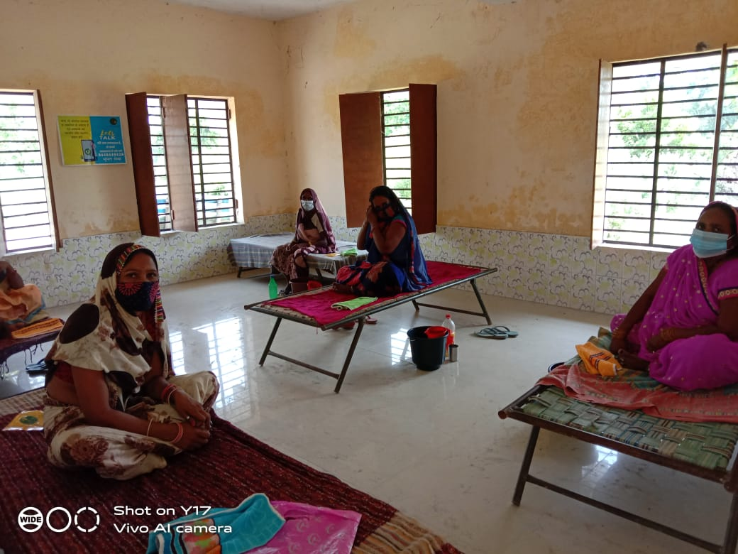
Facility Overview
Identify school or Panchayat Bhavan in the village with good ventilation
Capacity of 5-10 beds/room
Each bed to be separated 3 meters apart from all sides.
Mosquito net, if possible
Lighting, well-ventilation, electricity, ceiling fan and lights
Clean. Safe drinking water to be available
Functional clean toilets to be available
Where possible, television
Where possible, a vehicle for hire to transport patient to hospital

Slide 4
Break Out Room 1
Why is a COVID Care Center Important?
What do you think will happen if there is no facility for isolation in a village?

Slide 5
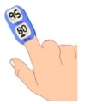
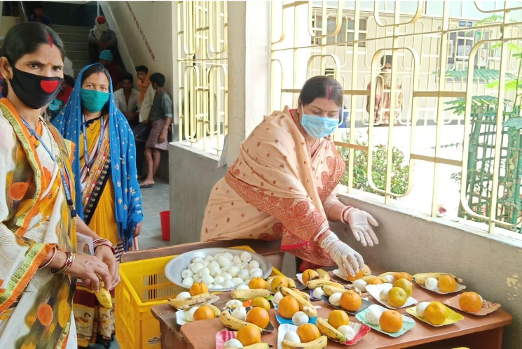
Patient Care Requirements
Monitoring of Patients
Temperature monitored with infrared thermometer
Pulse Oximeter for oxygen monitoring
Education of Patients
Patients educated on breathing exercises and proning when required
Educate patients on disposal of mask every 8 hours
Double masking
Teleconsulting with doctor
Services provided to Patients
Patients to be given three nutritious meals / day
Food can come from home
If not, set up community kitchen
Patients to be given clean and safe water
Surgical and cloth masks to be provided to patients
Access to doctors through teleconsultation & tele counselling
Daily check-in for every patient

Slide 6
Community Kitchen
In case the families are not able to supply food then a Community Kitchen will be set up in the village
A community kitchen should be set up close to the isolation center by the volunteers and leaders from the community
They should prepare the meals to meet the nutritional needs of the patients in the isolation centers
Food to be served to the patients in their own plates and the plates and other utensils used by the patients should be washed separately in hot water
No member of the community to enter the rooms where patients are staying to serve food
CSOs can support with supplementary nutrition requirements (egg, milk, Dhal, channa etc)

Slide 7
Isolation Center Flow Chart

Slide 8
Fever/Cough
Provision for Home Isolation
No
Yes
Referral Quarantine & Care Center
Stay at Home
Condition worsens- fever not coming down
Patient getting better in 3 days
Observe symptoms & O2 saturation, Refer for testing
Yes
Improvement in condition
NO Improvement
Send home after 14 days of symptoms & no fever for 10 days
Send / Stay Home for 14 days
Breathlessness, SpO2<92, chest pain,difficulty in breathing
Is referral possible
Continue with Proning
Oral Dexamethasone with prescription
Refer to Hospital
Yes
No

Slide 9
Oxygen Monitoring
The saturation is monitored by a pulse oximeter. The isolation center should have access to pulse oximeters (at least 2-3 per center) which need to be used by the patients to monitor their saturation every 6 hours.
Saturation | Action to be taken
95 and above | Continue monitoring and do breathing exercises
<-94 | Patient to keep lying in the prone position as shown below and keep doing deep breathing exercises Awake proning Passive leg movements Adequate hydration Oxygen if available Inhaled steroids (budesonide) – Dose 800mcg twice daily through the spacer or through nebulizer Steroids (Dexamethasone 6mg) with prescription from the doctor Monitor the saturation every hour Immediately reach out to the CHE or isolation center coordinator Arrange for an ambulance/vehicle and send the patient to the hospital

Slide 10
Proning

Slide 11
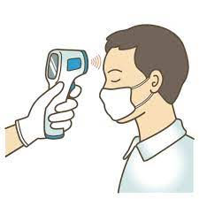
Monitoring Temperature
Temperature should be checked every 6 hours and reported to the Volunteer/ASHA on phone.
Paracetamol dose 1gm every eight to six hours can be advised if fever persistent
If the temperature is above 100 immediately call the doctor for consultation
Record of temperature and Saturation to be maintained by each patient in the attached template.

Slide 12
Monitoring Chart
Patient Name |  | Age | Gender
Name of relative |  | Contact number of relative
Date | Time | Temperature | Saturation

Slide 13
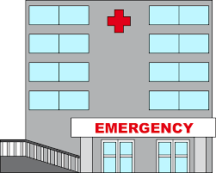
Serious Symptoms
Immediate medical attention must be sought if serious signs or symptoms develop. They are
Persistent fever > 7 days
Dyspnea (Shortness of breath)
Oxygen Saturation < 94%
Pulse Rate> 120/min
BP <90 mm Hg
Fall in urine output
Alteration in consciousness
Transfer to a higher centre – District hospital should be considered

Slide 14
Break Out Room 2
Who needs to be isolated and why?
Is it possible to set up a care center in your community?
If you were to set up, what is the kind of support you would need?

Slide 15
Caregiver Protocols
Daily check in with doctor for every patient
Double masking at all times
To wear protective gown and gloves
Hand hygiene followed at all times
Avoid touching eyes, nose or mouth
Avoid direct contact with body fluids of patient
Ensure patient follows prescribed treatment
Ensure counselling services through tele counselling whenever needed
Self monitor for symptoms

Slide 16
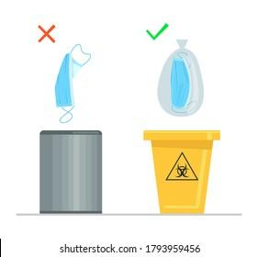
Biomedical Waste Management
All waste used like masks, gloves, etc. should be put in closed bin and handed to nearest hospital or PHC
Treat waste in 1% hypochlorite solution/sanitizer/bleaching solution before disposing

